Slide 1
Immersive Rigging and Skinning in Virtual Reality Environments
supervised by David Groß

Slide 2
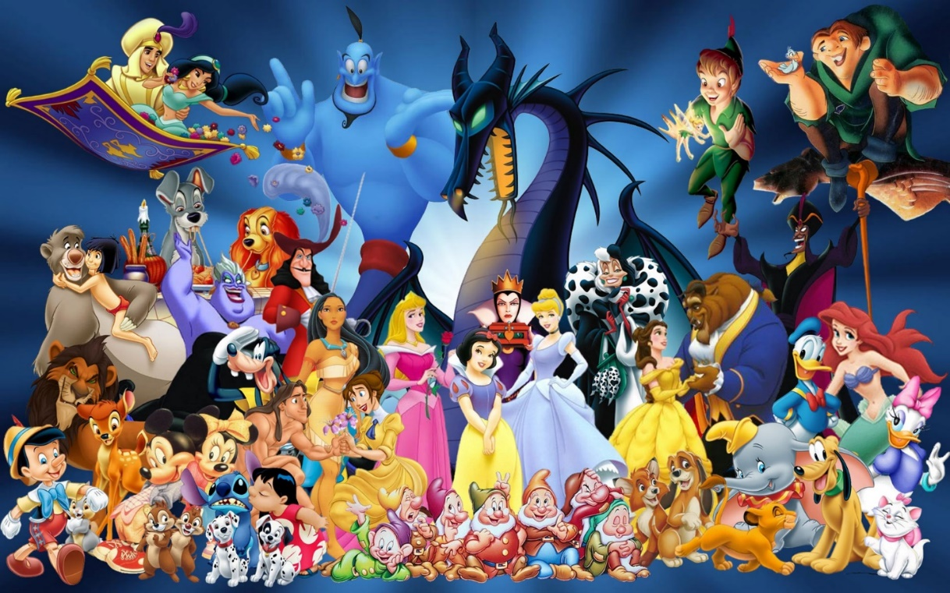
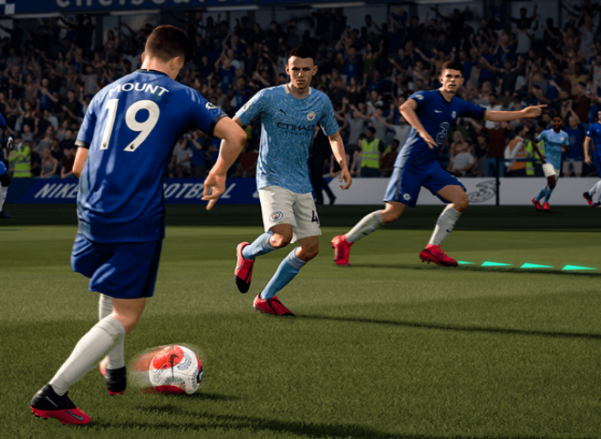
background
This project is about creating animation with the help of VR technology.
Animation is one of the main goals of CG
It is prevalent in films, video games, television series and so on.
Character animation brings Characters to life.

Slide 3
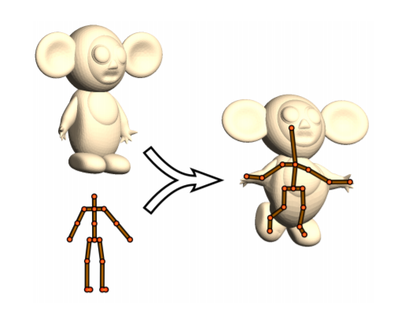
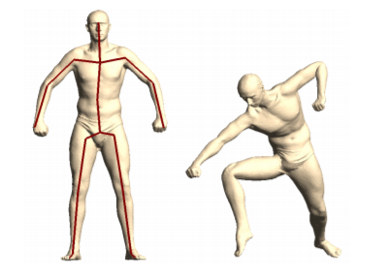
A brief introduction-immersive rigging and skinning
Character Animation needs Rigging and skinning
What is Rigging?
Define a skeleton for a given Mesh.
What is skinning?
Bind mesh to the skeleton.
Before skinning: mesh is not affacted by the skeleton.
After skinning: mesh follows the skeleton movements.
rigging
skinning

Slide 4
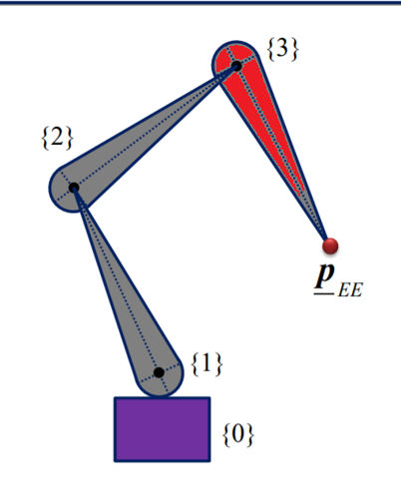
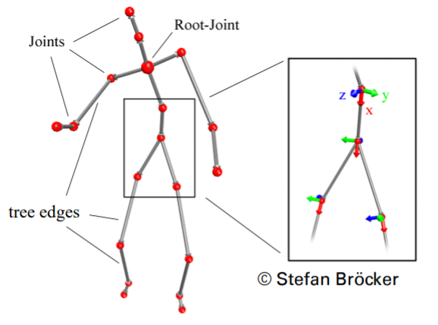
A brief introduction（Rigging）
How bones are defined?
What about a skeleton?
Bone root
Bone tip

Slide 5
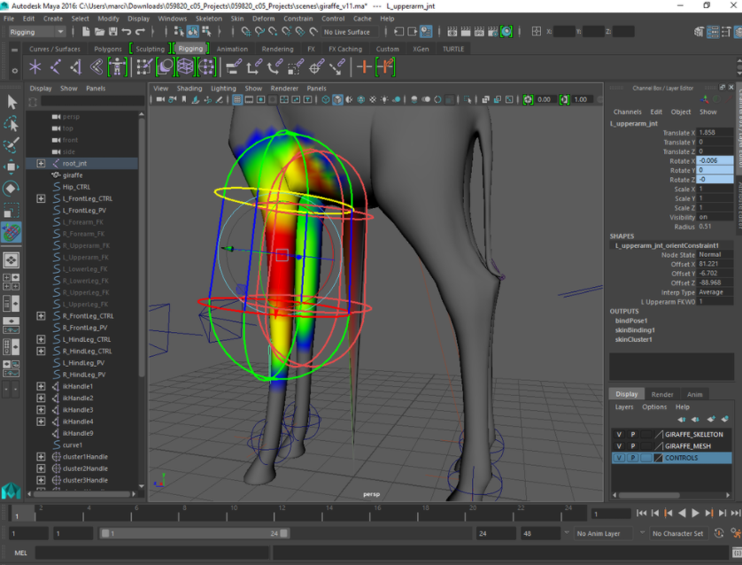
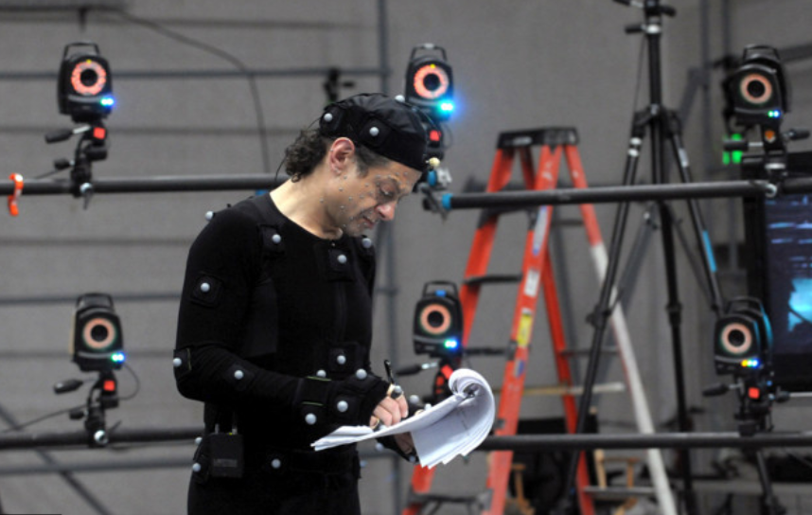
Motivation-Why Rigging and Skinning in immersive env
Rigging and skinning of 3d models usually involves sophisticated algorithms for fitting skeletons into meshes.
To gather realistic movement data, complicated motion capturing system may needed.
Those are changed by VR!
Immersed in a VR environment, the user finds himself in a familiar coordinate space, working with 3d models is intuitive.
Interactively creation and manipulation of a skeleton with ease.
Traditional rigging/skinning process
Traditional Mocap System

Slide 6
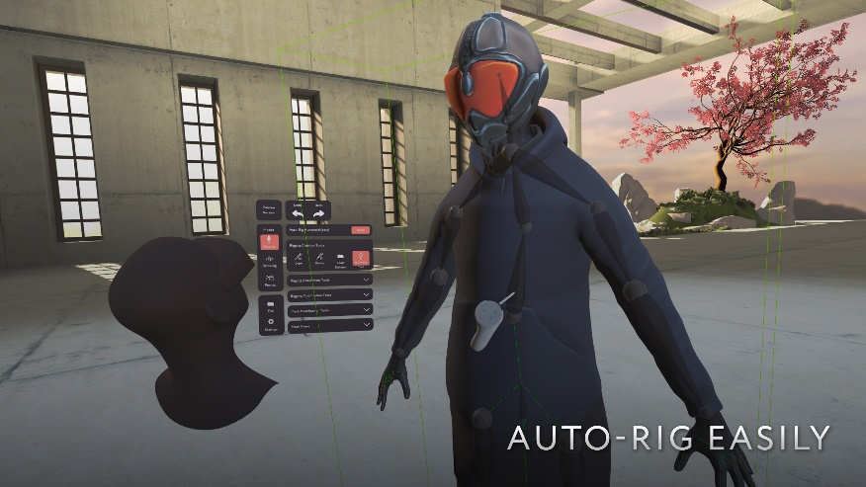
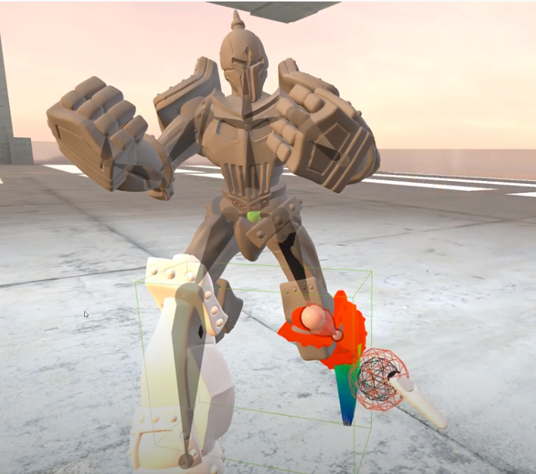
Related works (Immersive rigging)
MasterpieceVR
Pros:
Mirroring bones
Intuitive skinning tool
Cons:
Switch between diff. Skeleton types. (BVH, )
Define Dofs for each bone.
Apply user‘s motion to the model.
https://www.youtube.com/watch?v=NcByctd_PNg

Slide 7
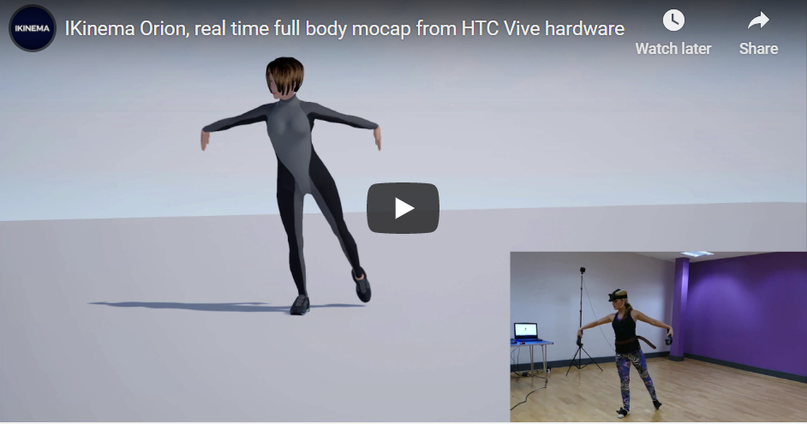
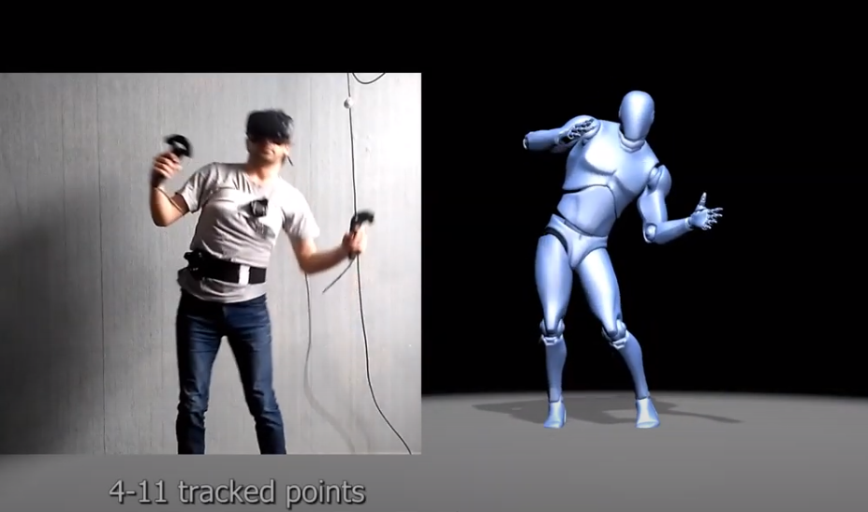
Related works (motion capturing with IK)
Ikinema
VR Mocap Studio
Pros:
Low cost, user friendly (gamers).
No need for specific calibration (Ikinema, not the other).
Cons:
Dof adjestments may not supported
Custom skeletons may not supported
At least 4 trackers
Artifacts
https://www.youtube.com/watch?v=Khoer5DpQkE
https://www.youtube.com/watch?v=QUsJbcyeRUI

Slide 8
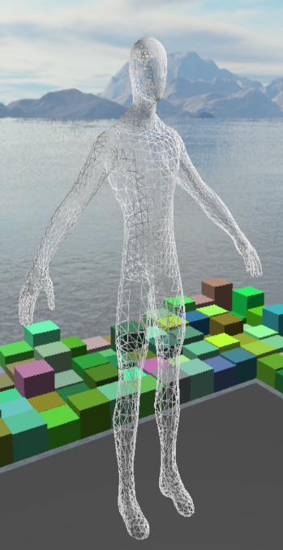
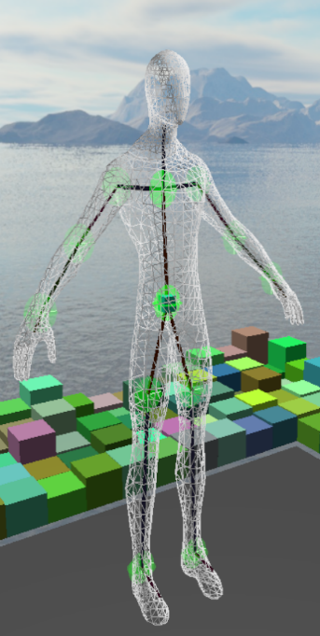
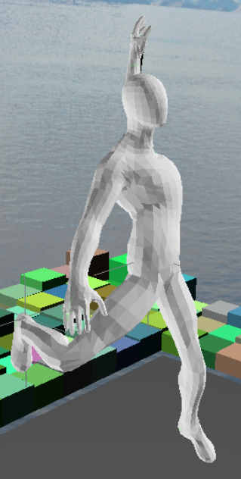
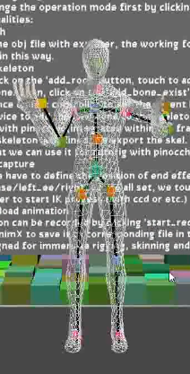
Main tasks/ System overview
Simple and extensible framework for Rigging, Skinning, Animation and Motion Capturing
Mocap/
Rigging
Animation
Skinning
Refine
Overview
Notes:
deeper explaination of the workflow

Slide 9
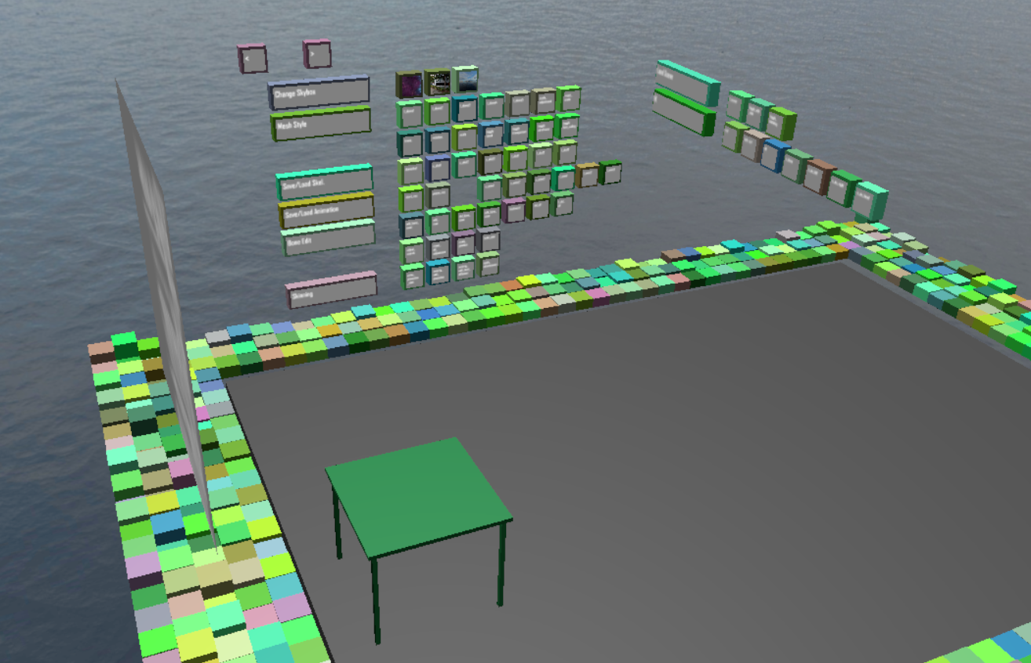
Basic user interface
Task 1: The „BoxGui“
flexible and extensible:
A simple solution for interaction. Different kinds of widgets are supported. Buttons can easily be managed into groups.
There is a “boxgui_button” class to manage the properties of the buttons. In a header file called “BoxGui.h”.
Visual feedback: a pushing effect
provided when intersection happens between the ray emitting from right hand controller and the button.
But
can only support a few words on each button, which makes it a little bit hard for users to know the functionalities.
Buttons are arranged on a virtual wall. They are assigned to random colors.

Slide 10
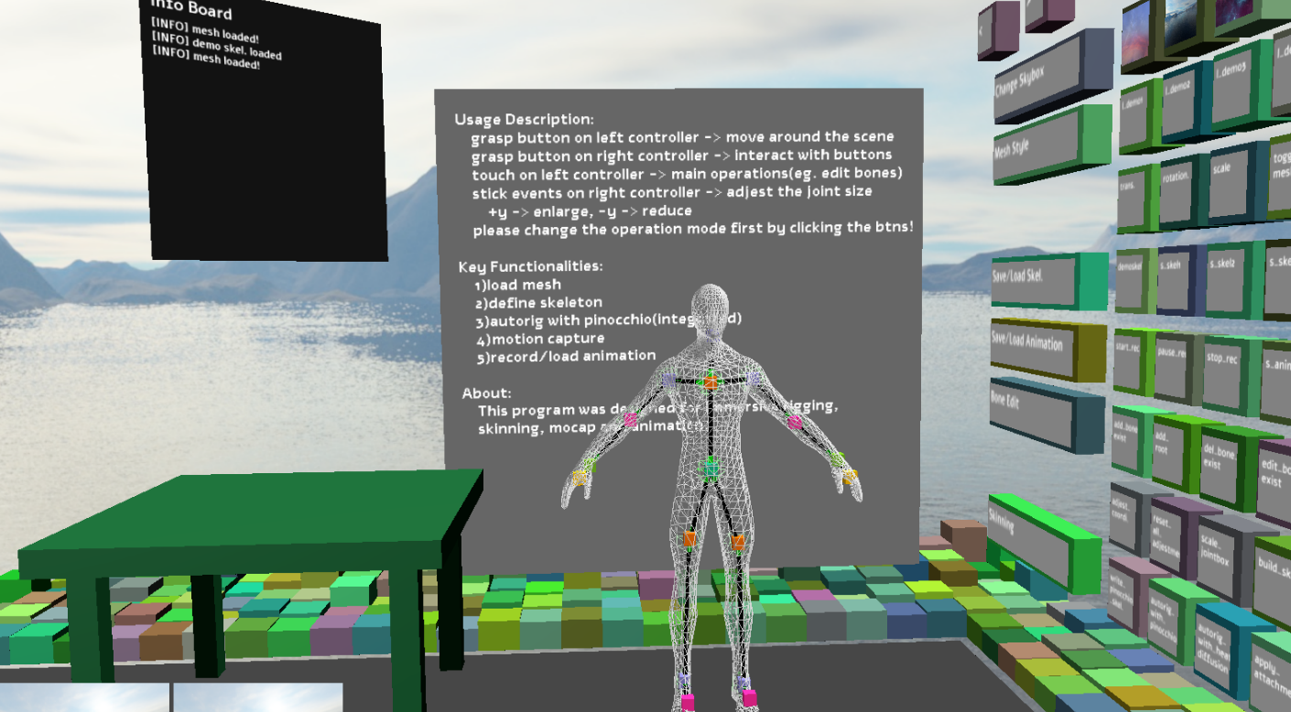
Create and manipulate bones for a given mesh
Task 2:
2.1: Render A Given Mesh
A custom mesh renderer:
It contains a vertex shader, a geometry shader, a fragment shader, and some c++ codes to upload/ update data. E.g. bone attachment matrices, model view matrix, and some Boolean variables. The mesh can thus be adjusted according to bone movement.
Different rendering modes possible:
One can render the given mesh in one of the following modes: transparent mode, wireframe mode and back face culling.
The view from the initial pose, and the mesh is rendered in wireframe mode.

Slide 11
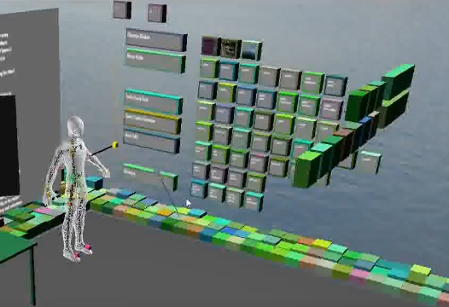
Create and manipulate bones for a given mesh
2.2: Modifications to An Existing Skeleton
Iteratively:
A load of a predefined skeleton from disk is supported. That means one can continually refine a skeleton in a simple way.
Flexible:
It is quite flexible that skeletons can be defined for a given mesh in any shape.
Currently supported operations:
One can add, delete and move the selected bone.

Slide 12
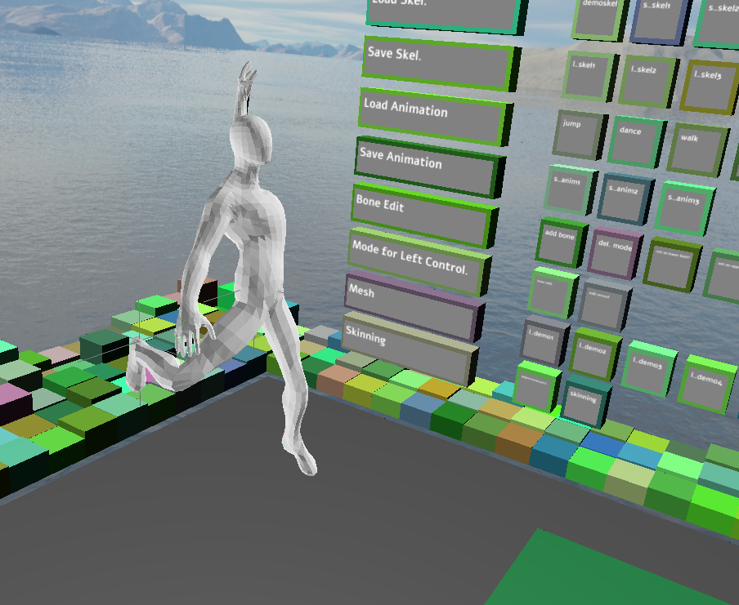
Skinning of a mesh with the created skeleton
Task 3: Skinning With Pinocchio Library
Generate a skeleton:
When rigging is finished, a skeleton is defined and transformed to a special format which can be feed into Pinocchio.
Load attachments:
The attachment data for bones is available as output file. We have to load it explicitly in the VR scene, by clicking the “apply_attachments” button.
Alternative:
As the skeleton is defined according to the given mesh directly, we can assume that it will fit the mesh well. Thus a custom skinning tool may be a better choice. This belongs to future work.
The given mesh can be adjusted according to the skeleton. Which provides an animation effect. Here we take the spiderman as an example.

Slide 13
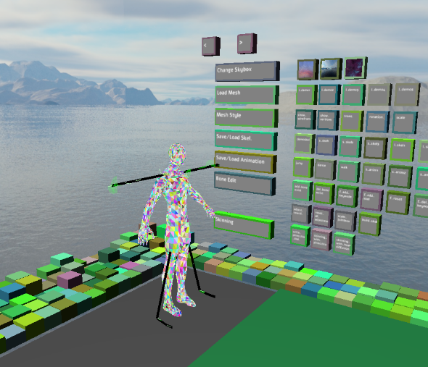
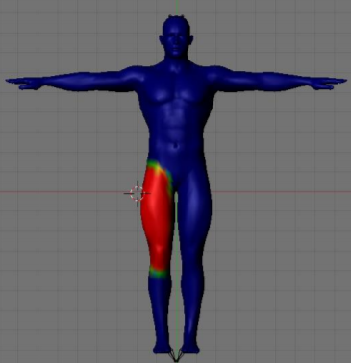
Visualize the skinned mesh
Task 4: Visualize The Skinned Mesh
Method1:
We can visualize a skinned mesh by varying the position/ direction of individual bones.
Method2:
Individual bones can be colorized , depending on the bone weights.
The skinned mesh can be visualized in more than those two ways.

Slide 14
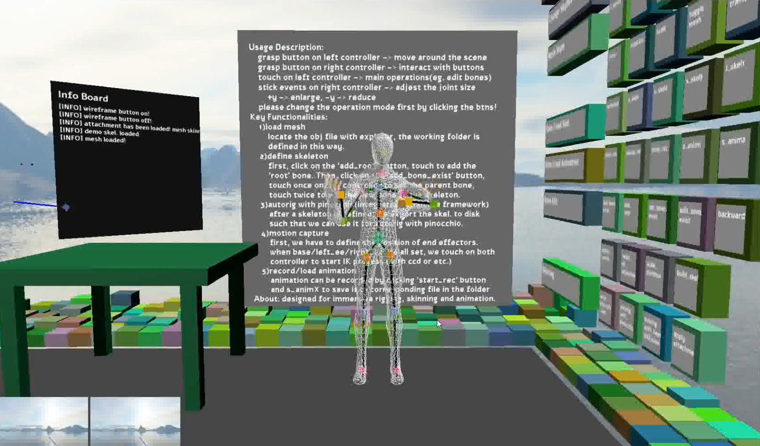
Record users movement with ik
Task 5: Record Users Movement with IK
capture the user movements in VR
we can define target positions with the help of controller positions as well as headset position. (Or other trackables) The other parts of the skeleton of the character can be adjusted accordingly with help of IK algorithm.
We may not get an accurate result,
But an acceptable result of the motion can be captured without special equipments.
Which is suitable for the case of VR games and some other similar applications.
A acceptable result can be acquired with minimal effort.

Slide 15
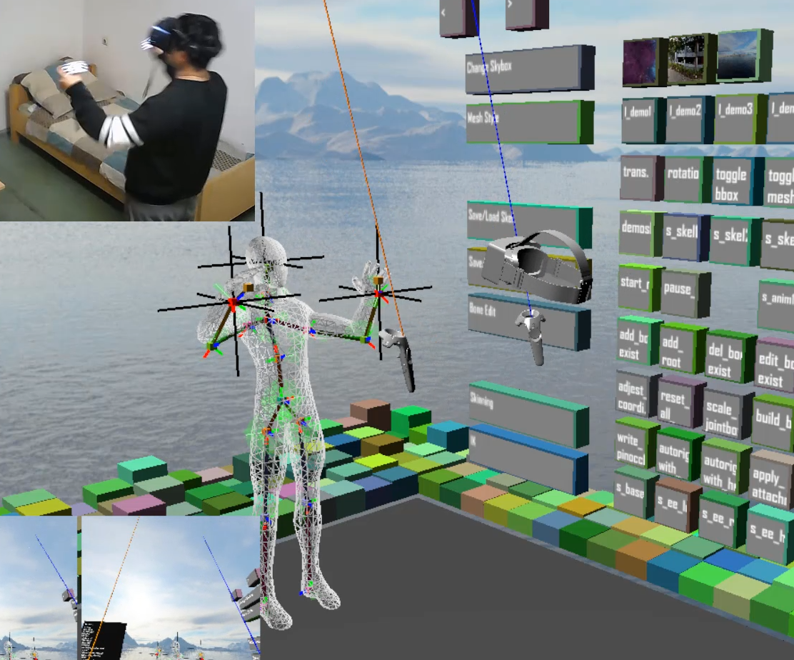
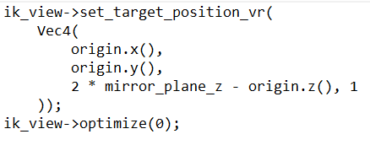
Record users movement with ik
How can we control the 3d avatar?
Compute target positions with the help of current user’s state.

Slide 16
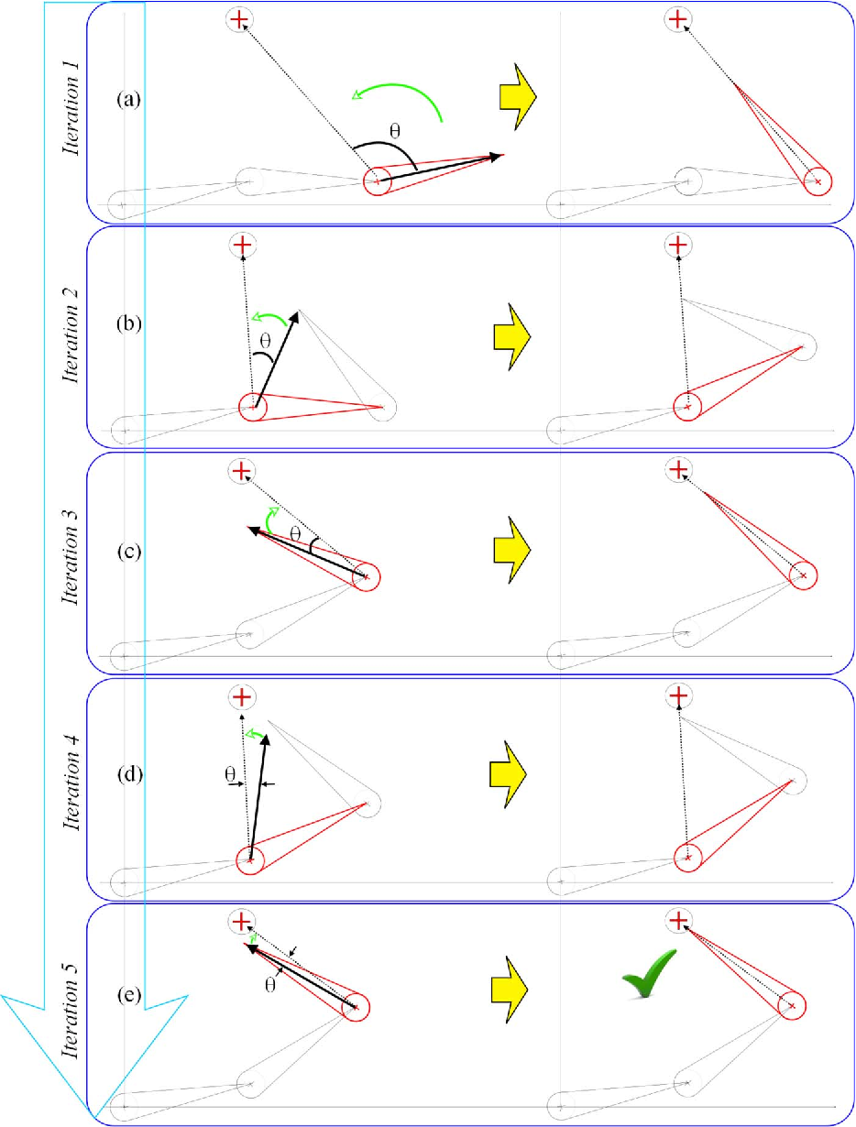
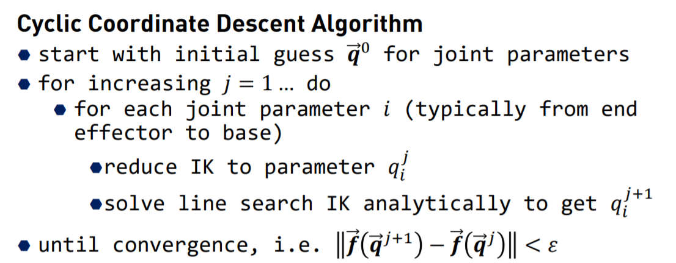
Record users movement with ik
How does IK work? (CCD)
Input: target position
Output: list of dofs along the kinematics chain.
The algorithm is currently imported to my system without modification. I directly used it to compute the pose of the chains.
From slides CG2_SS19_10_IK, Prof. Gumhold
doi: 10.1080/2165347X.2013.823362

Slide 17
Record users movement with ik
How to Support IK algorithm with multiple targets?
Multiple target positions
CCD can not handle multiple end effectors when there are conflicts along kinematic chains.
I chose thorax to be the base bone when controlling with two controllers and hmd. Thus, no conflicts.
If we want to record full body movements, FABRIK algorithm can be used.

Slide 18
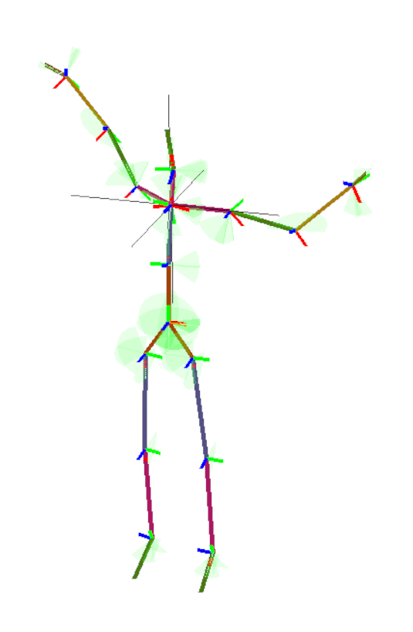
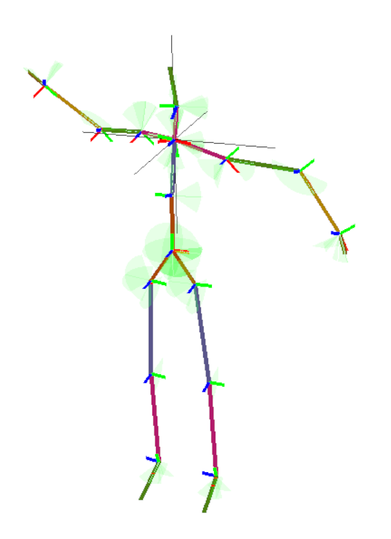
Record users movement with ik
no“conflicts”, the two chains are independent
Target position
Base bone

Slide 19

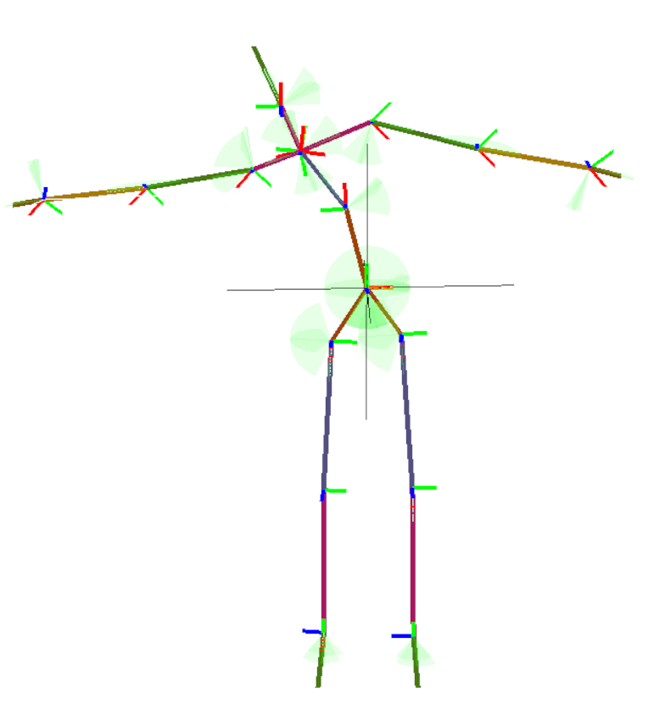
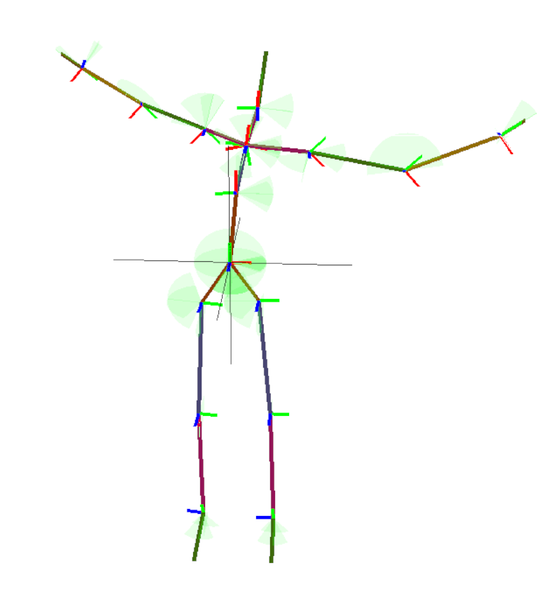
Record users movement with ik
Those two chains have “conflicts”
step1
step2
Target position
Base bone

Slide 20
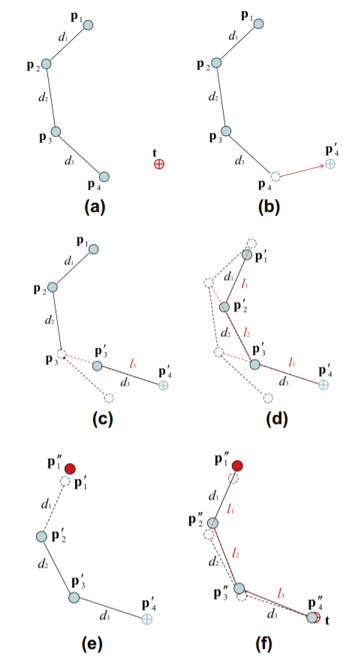
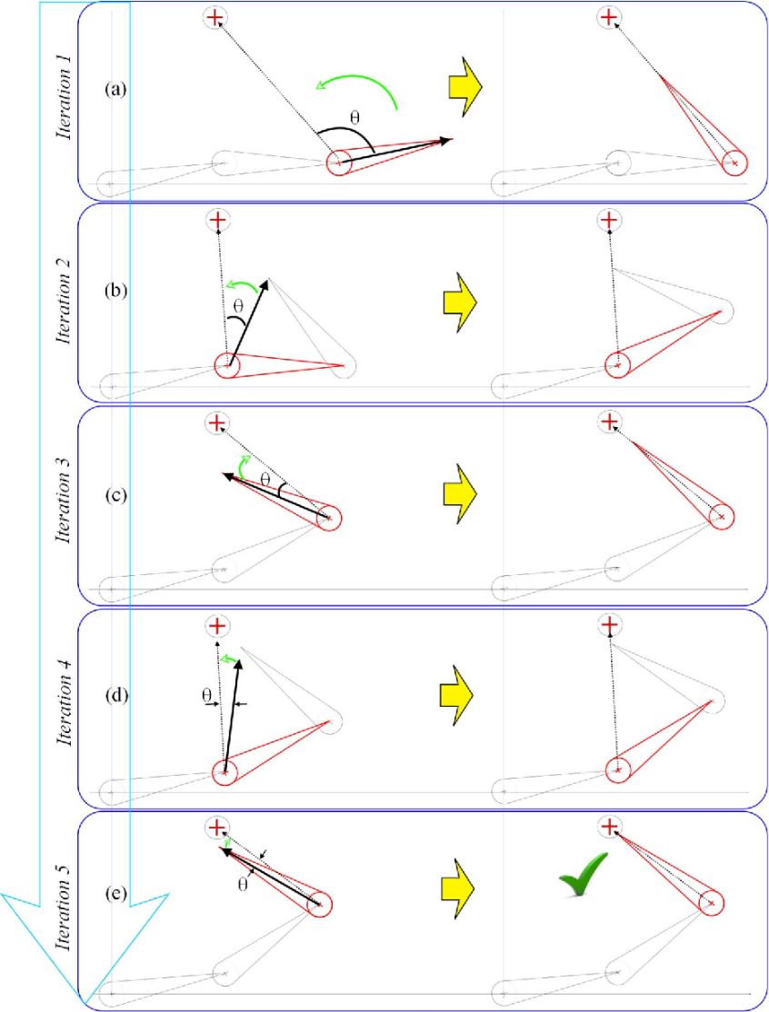
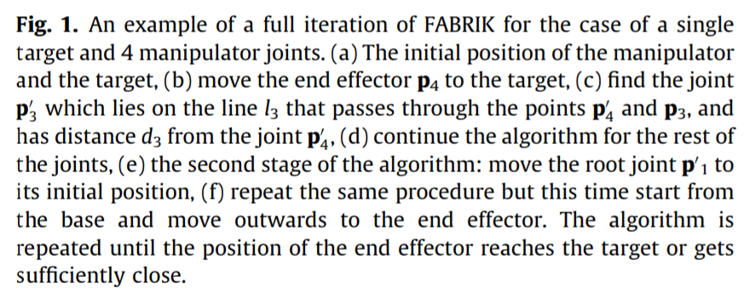
Record users movement with ik
The FABRIK algorithm
CCD is angle based while FABRIK is distance based algorithm!
https://doi.org/10.1016/j.gmod.2011.05.003

Slide 21
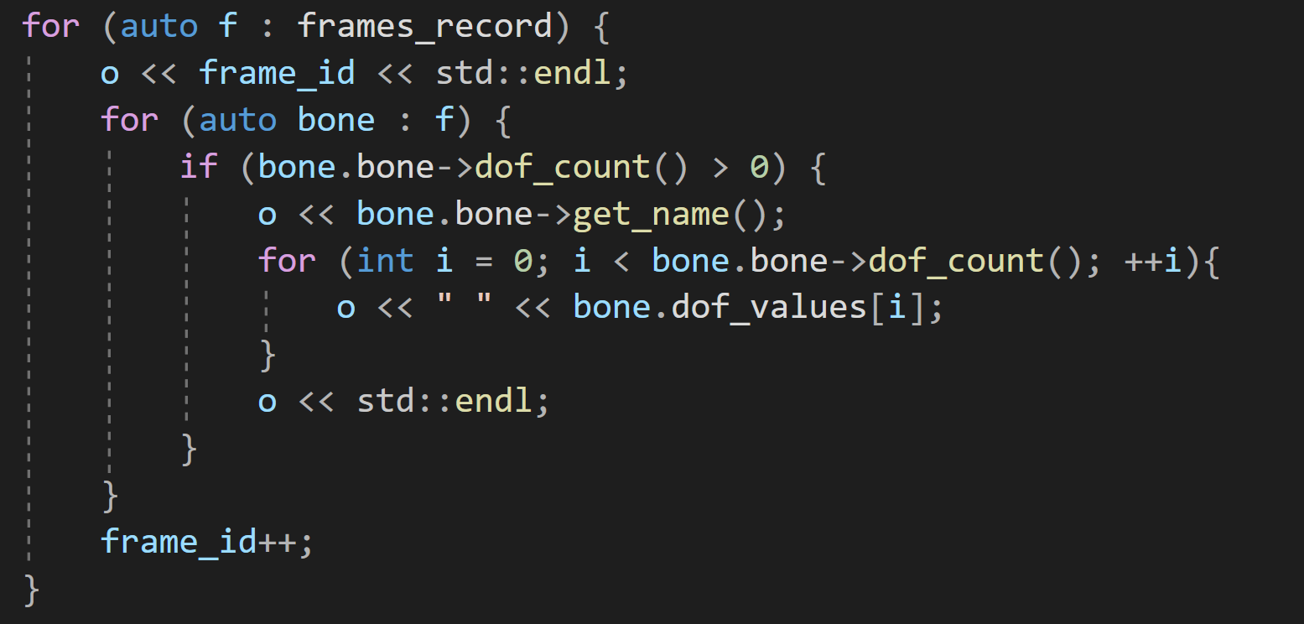
Recording, saving animations
6) Recording, Saving Animations
On GUI:
Animations can be loaded and played with the help of GUI buttons in the scene.
Implementation Detail:
Animation can be recorded frame by frame. Each frame contains a list of bone dofs.
Feature:
Adjestable framerate. Which is 60Hz now. The Output is a file with .anim extension.

Slide 22
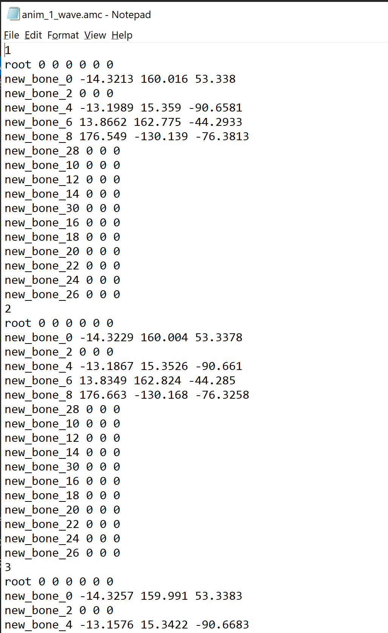
Task 6: Recording, Saving Animations
Implementation Detail:
Animation can be recorded frame by frame. Each frame contains a list of all bone dofs.

Slide 23
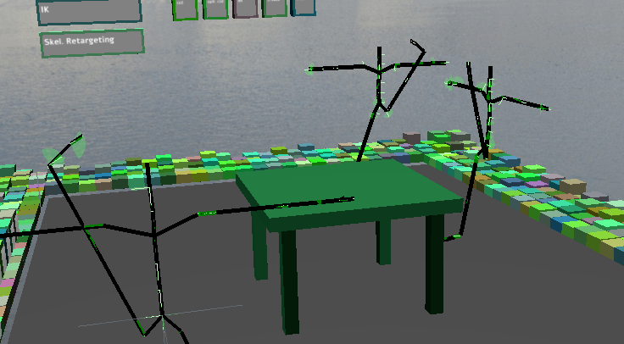
Creating multiple views
Task 7: Creating Multiple Views
To support mirror effect, multiple skeletons are imported to the scene. As can be seen on right side.
One main skeleton can be controlled by user and the other two imitates it.
As for detail, just iterate all bones of the other two skeleton and assign the dofs the same as the one we want to initate.
Multiple skeletons

Slide 24
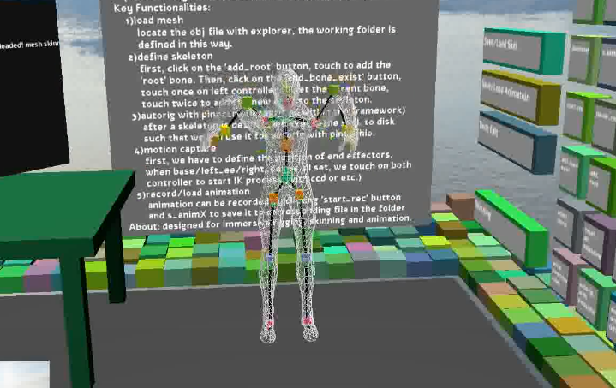
Evaluation of the stability of the mocap (Future work)
Task 8: Evaluation
Orientation information is not used. Only positions are fed to IK, where the orientation of end effectors should also be used. (otherwise, body will be twisted easily)
Such a motion capture scheme does not guarantee an accurate result. IK problems may be ill-posed. (no solution in range or many solutions exist)
Full body motion capture not available.
This can be cured by adding more trackers and taking use of the FABRIK algorithm.
IK based Mocap

Slide 25
summary
Rigging, Skinning, Animation and Motion Capturing are ported to vr as a whole system.
Mocap/
Rigging
Skinning
Animation
Refine

Slide 26
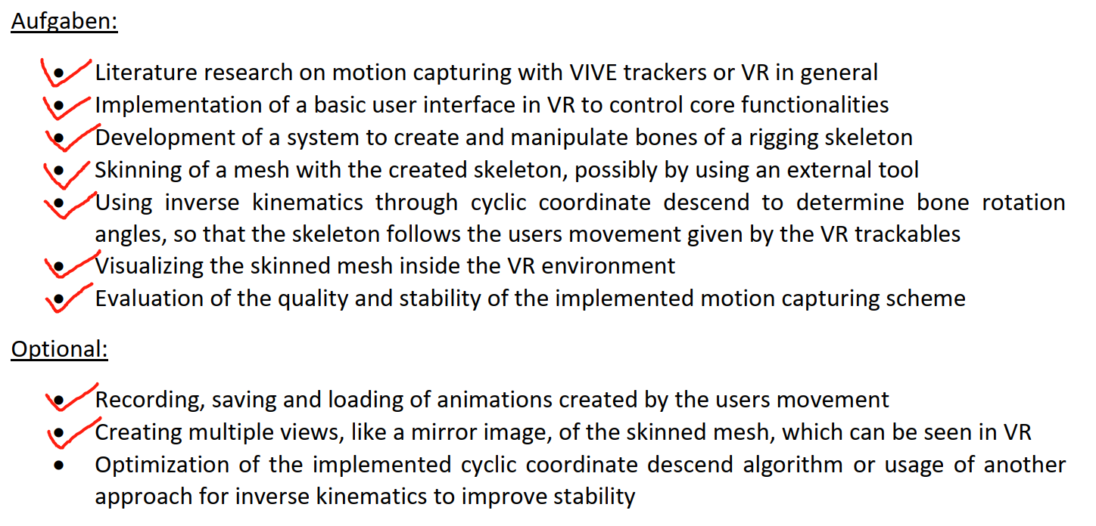
tasks

Slide 27
THANKS FOR YOUR LISTENING !!

